Slide 1
ML for 88 Acres Phase 2
Mike Wise
Architect – MCS HQ Applied Incubation
3 Sep 2015

Slide 2
Phase 1
Ingested 2 years of data of building data from Ionics Historians into HDInsight Cluster
1.5 TB of data
92 buildings
Analyzed and Cleaned data
Created Energy Prediction models using 2 techniques
Delivered and deployed 20 energy prediction models (from weather)
Pilot Deployment in 88 Acres ROC is proceeding

Slide 3
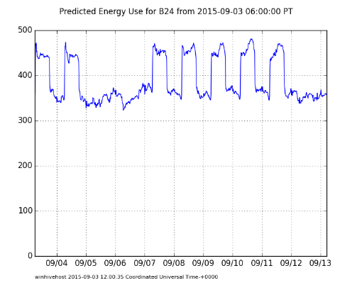
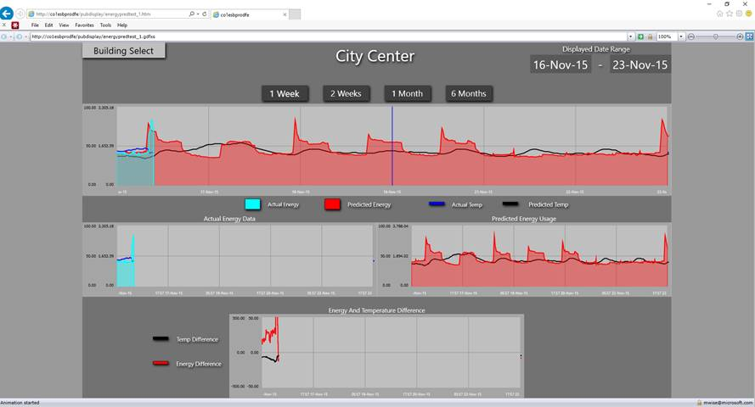
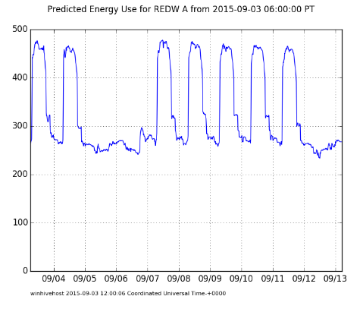
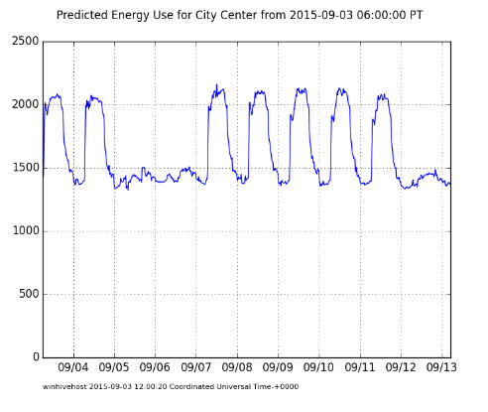
Pilot
21 Buildings with predictions updating once an hour
Models are increasingly out of date, and thus more likely to encounter different weather conditions than they were trained on
Peak Energy Consumption Reduction already possible with this model

Slide 4
Goals for Phase 2
Create more accurate energy prediction models
Develop prediction models that can be used for control
Create predictive maintenance models for chillers
Redesign prediction architecture so that it can be deployed in Azure in a vendor independent manner

Slide 5
ML for 88 Acers Architecture – Phase 2
Data Orchestration driven by ADF
ADF in development
ADF does not yet support Python Activities, but promised real soon now ☺

Slide 6
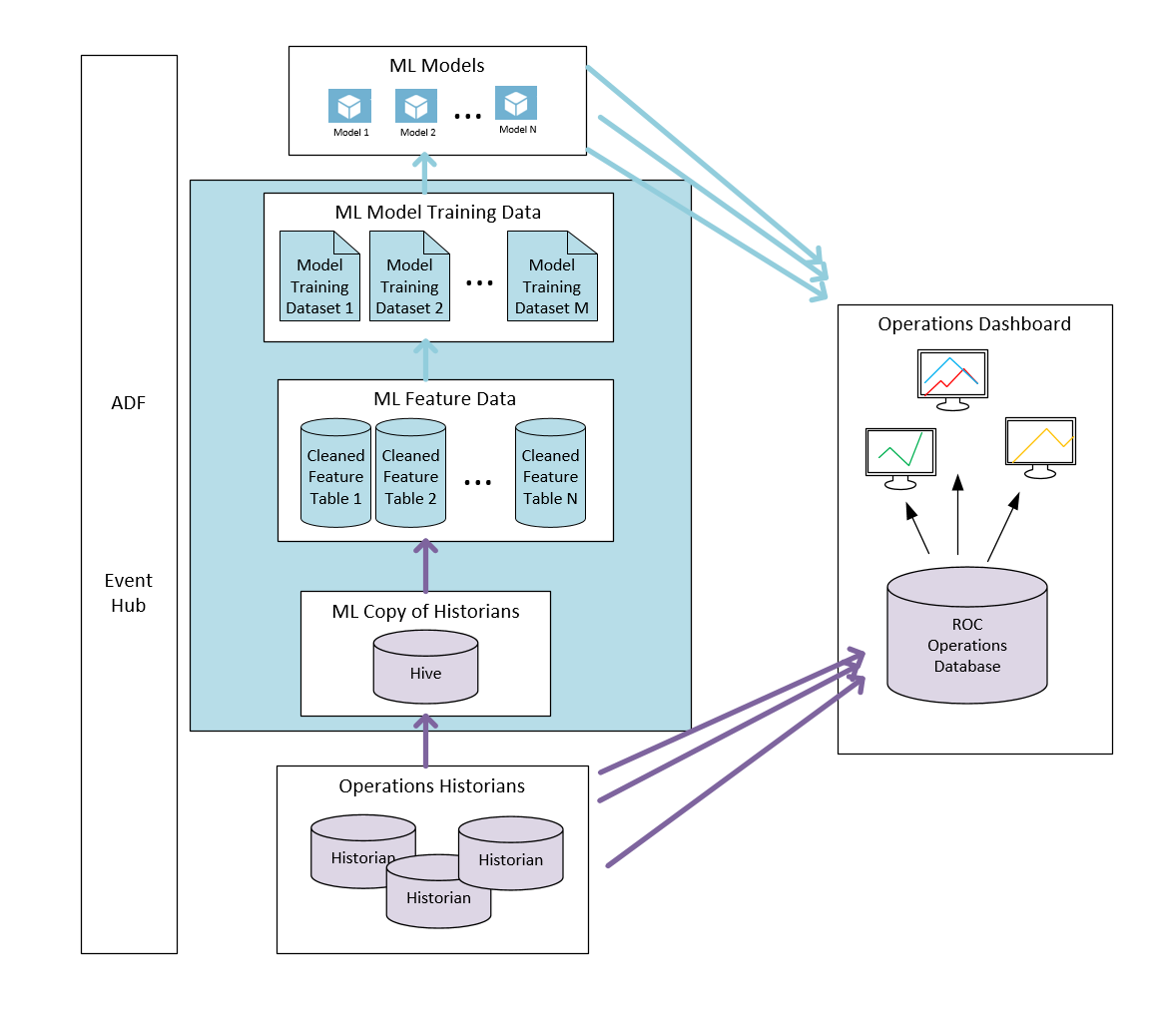
Vendor Independent Data Architecture
Need Vendor Independent Scheme
Haystack might provide valuable guidance
Vendor Independent in Cyan
Vender Specific in Magenta

Slide 7
Phase 1 Energy Prediction Data Flow
We trained up a model in one block
We then used that model for predicting in one block
Data flow was simple
No building state (except headcount)
Predictions are independent of previous predictions

Slide 8
What we need to do

Slide 9
Limitations of approach
Because there is no state, we cannot know if the building is warm
The control variables (occupancy and thermostat settings) are not a part of the model, implicitly accounted for in time variation
Model cannot generalize to a command-and-control model (prescriptive analytics)

Slide 10
Phase 2 Energy Prediction Data Flow
Add state variables and control variables
Implies need to train 3 (or more) models per building
The models have to be used step-by-step in prediction

Slide 11
Phase 2 Energy Control Data Flow
With this model the engineer can control the energy consumption in a predictable way by changing the OCC values centrally

